Slide 1
Chapter 24 THE NATURE AND PROPAGATION OF LIGHT
24.1 The Nature of Light
24.2 Reflection and Refraction
24.3 Total Internal Reflection
24.4 Dispersion
24.5 Polarization
24.6 Scattering of Light
24.7 Huygens’s Principle

Slide 2
Goals for chapter 24
To overview light and its properties
To study reflection and refraction
To examine the unique phenomenon of total internal reflection
To consider the polarization of light
To see polarization by reflection
To study Huygens’s Principle

Slide 3
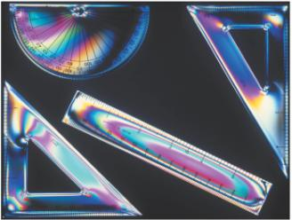
Introduction
A coating of oil on water or a delicate glass prism can create a rainbow. A rainstorm among open patches of daylight can cast a conventional rainbow. Both effects are beautiful and arise from the wavelength dependence of refraction angles.
Eyeglasses or contact lenses both use refraction to correct imperfections in the eyeball’s focus on the retina and allow vision correction.

Slide 4
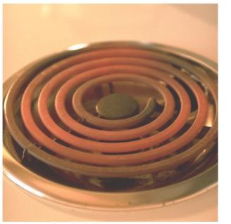
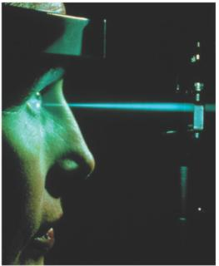
24.1 The Nature of light
The wave–particle duality of light was not well understood until Albert Einstein won his Nobel Prize in the early 20th century. It was a tenacious understanding of light that led to quantum mechanics and modern physics.
Black-body and laser radiation look so different but are brother and sister.

Slide 5
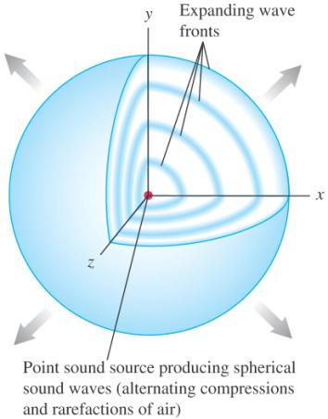
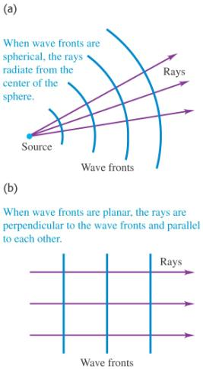
Wave, wave fronts and rays
Light is actually a nearly uncountable number of electromagnetic wave fronts, but analysis of refraction or reflection are made possible by treating light as a ray.

Slide 6
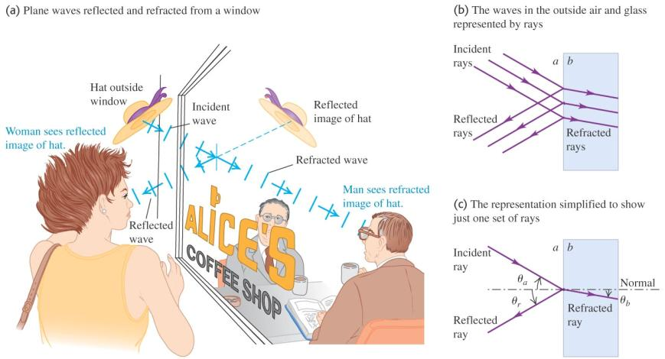
Reflection and refraction
Figure illustrates both reflection and refraction at once. The storefront window both shows the passersby their reflections and allows them to see inside.

Slide 7
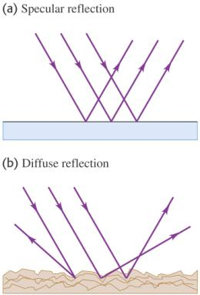
We will consider specular reflection
A real surface will scatter and reflect light. Diffuse reflection is the rule, not the exception. We will use specular reflection as we used the ray approximation, to make a very difficult problem manageable.

Slide 8
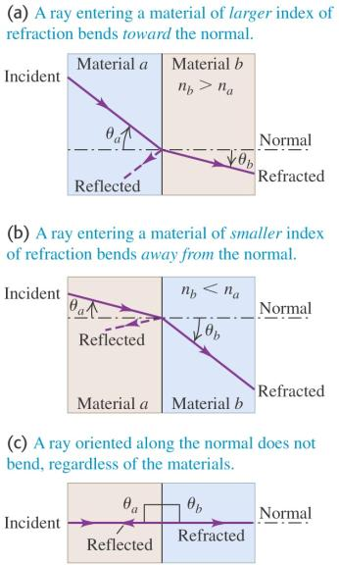
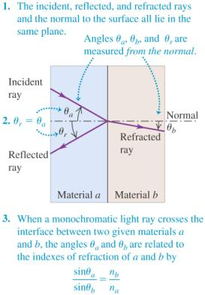
Laws of reflection and refraction
Angle of incidence = angle of reflection.
Snell’s Law of Refraction considers the slowing of light in a medium other than vacuum … the index of refraction.

Slide 9
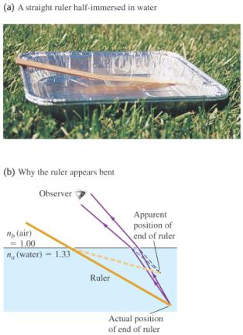
Why should the ruler appear to be bent?
The difference in index of refraction for air and water causes your eye to be deceived. Your brain follows rays back to the origin they would have had if not bent.

Slide 10
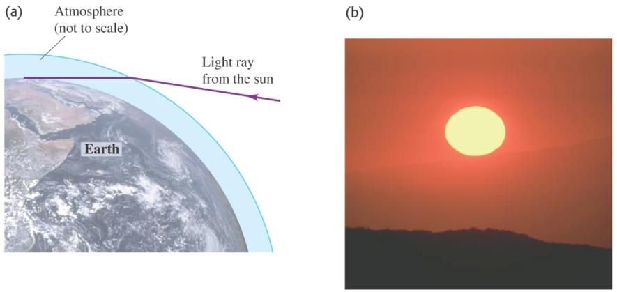
Why should sunsets be orange and red?
The light path at sunset is much longer than at noon when the sun is directly overhead.

Slide 11
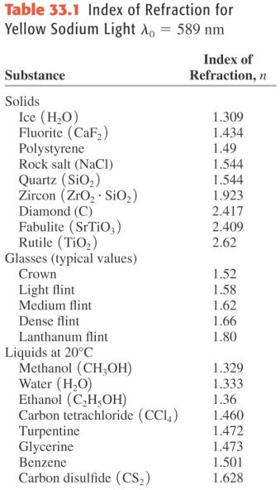
Tabulated indexes of refraction

Slide 12

Index of refraction and the wave aspects of light
What happens when the light passes from one materials to another material with a different index of refraction.
The frequency f of the wave does not change when passing from one material to another. But the wavelength of the wave is different in general in different materials.

Slide 13
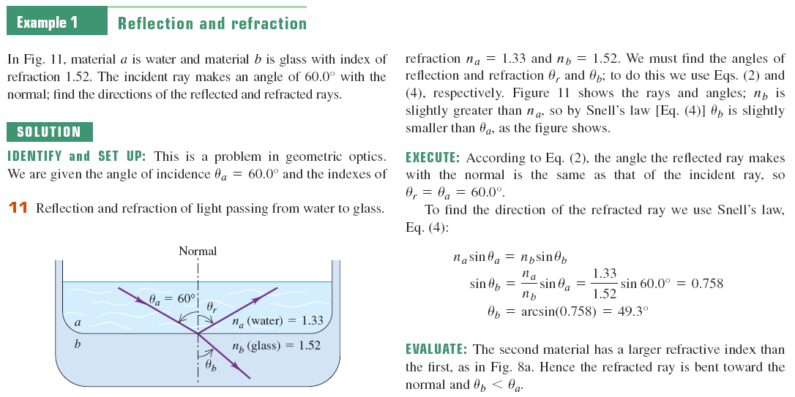

Slide 14
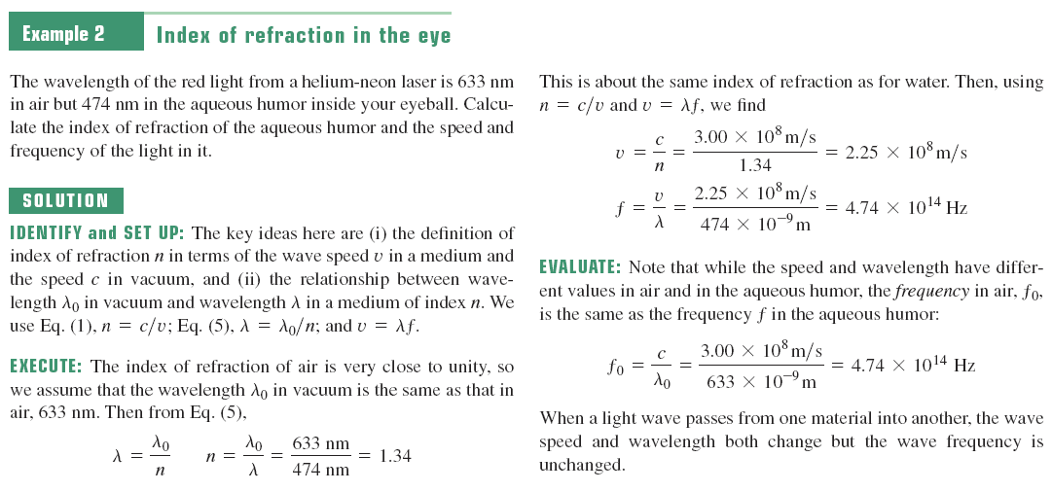

Slide 15
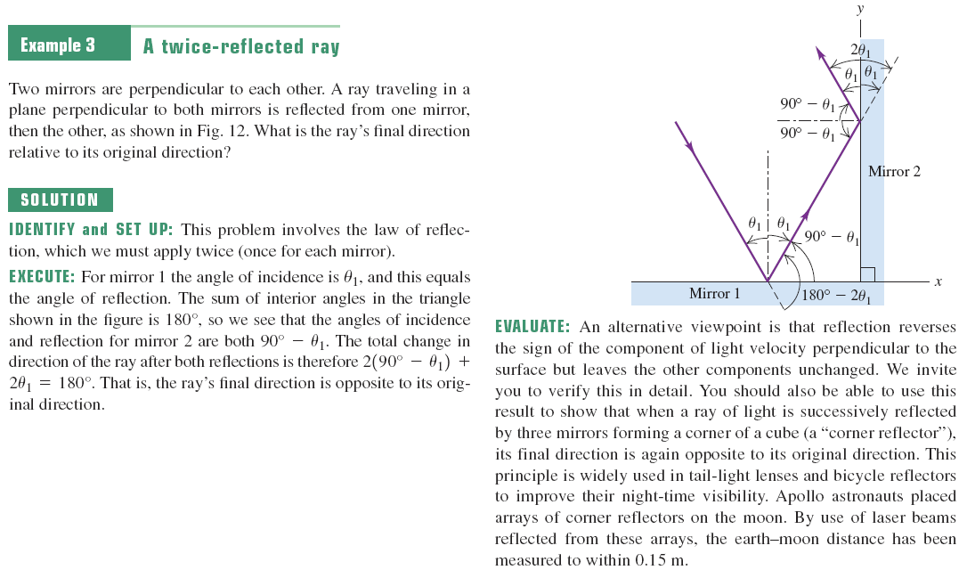

Slide 16

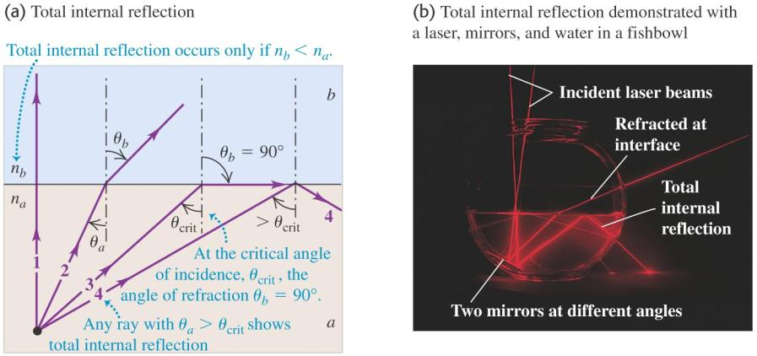
Total internal reflection I
As the angle of incidence becomes more and more acute, the light ceases to be transmitted, only reflected.

Slide 17
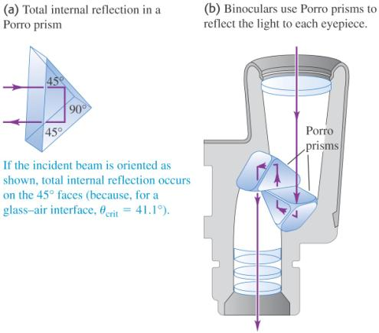
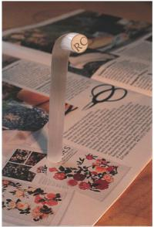
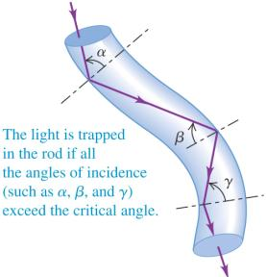
Total internal reflection II
Using clever arrangements of glass or plastic, the applications are mind boggling.

Slide 18
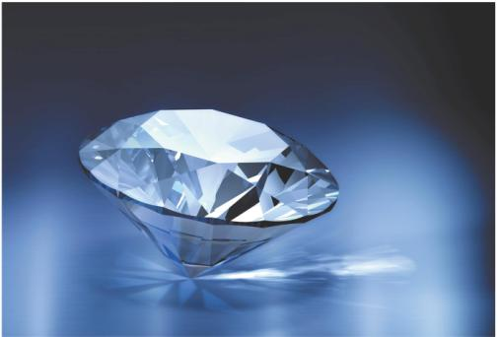
Total internal reflection III
Diamonds sparkle as they do because their index of refraction is one of the highest a transparent material can have. Nearly all light that enters a surface ends up making many passes around the inside of the stone. The effect is only amplified by cutting the surfaces at sharp angles.

Slide 19
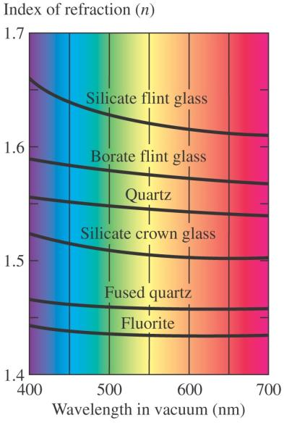
Dispersion
From the discussion of the prism seen in earlier slides, we recall that light refraction is wavelength dependent. This effect is made more pronounced if the index of refraction is higher. “Making a rainbow” is actually more than just appreciation of beauty; applied to chemical systems, the dispersion of spectral lines can be a powerful identification tool.

Slide 20
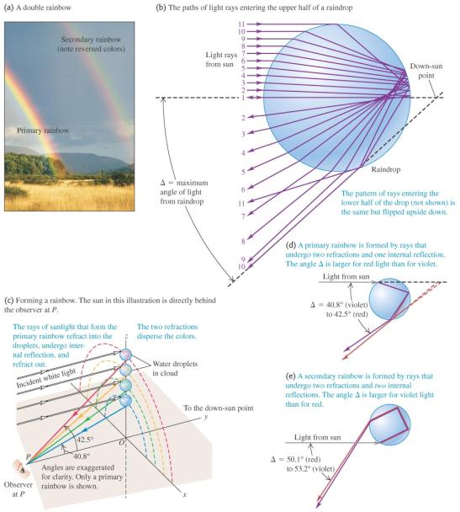
Special case—dispersion and atmospheric rainbows
As a person looks into the sky and sees a rainbow, he or she is actually “receiving light signals” from a physical spread of water droplets over many meters (or hundreds of meters) of altitude in the atmosphere. The reds come from the higher droplets and the blues from the lower (as we have seen in the wavelength dependence of light refraction).

Slide 21
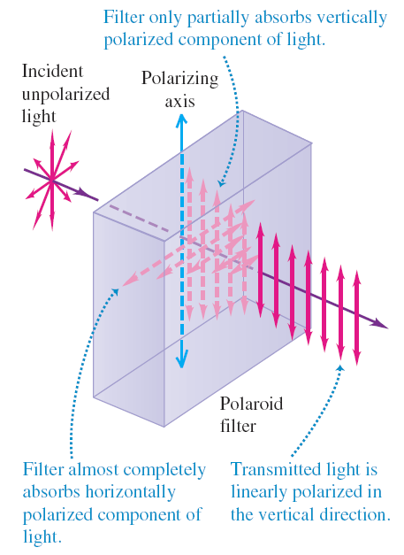

Selecting one orientation of the EM wave—the Polaroid
A Polaroid filter is a polymer array that can be thought of like teeth in a comb. Hold the comb at arm’s length with the teeth pointing down. Continue the mental cartoon and imagine waves oscillating straight up and down passing without resistance. Any “side-to-side” component and they would be blocked.

Slide 22
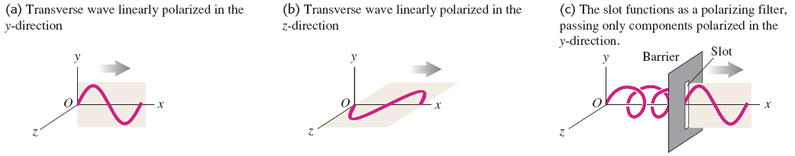
Polarization I
Polarization is a characteristic of all transverse waves.
A wave has only y-displacement, we say that it is linearly polarized in the y-direction. For mechanical waves we can build a polarizing filter or polarizer, which can permit only waves with a certain polarization direction to pass.
A electromagnetic wave is a transverse wave. The fluctuating electric and magnetic fields are perpendicular to each other and to the direction of propagation.

Slide 23
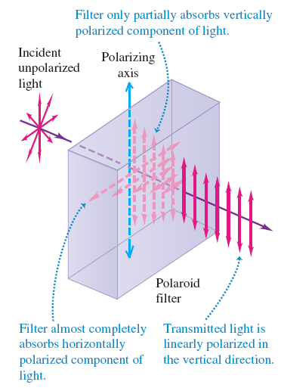

Unpolarized light
Light with a random mixture of waves linearly polarized in all possible transverse directions, called unpolarized light or nature light.

Slide 24
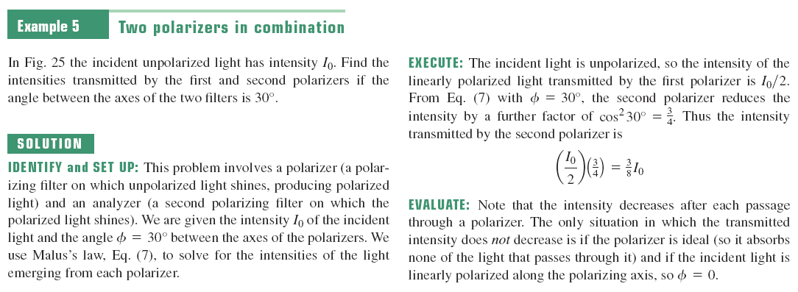

Slide 25
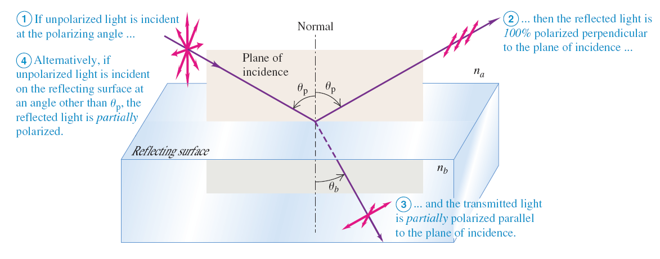
Polarization by reflection
By reflection from a surface?

Slide 26
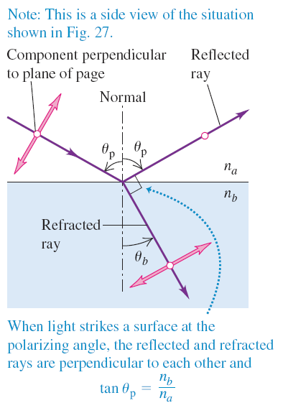

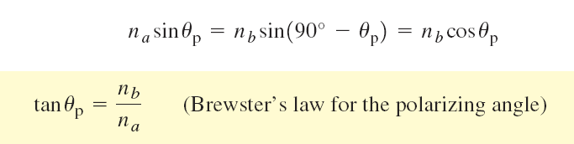
Brewster’s law
But at one particular angle of incidence, called the polarized angle θ_{p}, the light for which E lies in the plane of incidence is not reflected at all but is completely refracted.
In this case the angle of refraction θ_{b} equals 90°-θ_{p}. From the law of refraction.

Slide 27
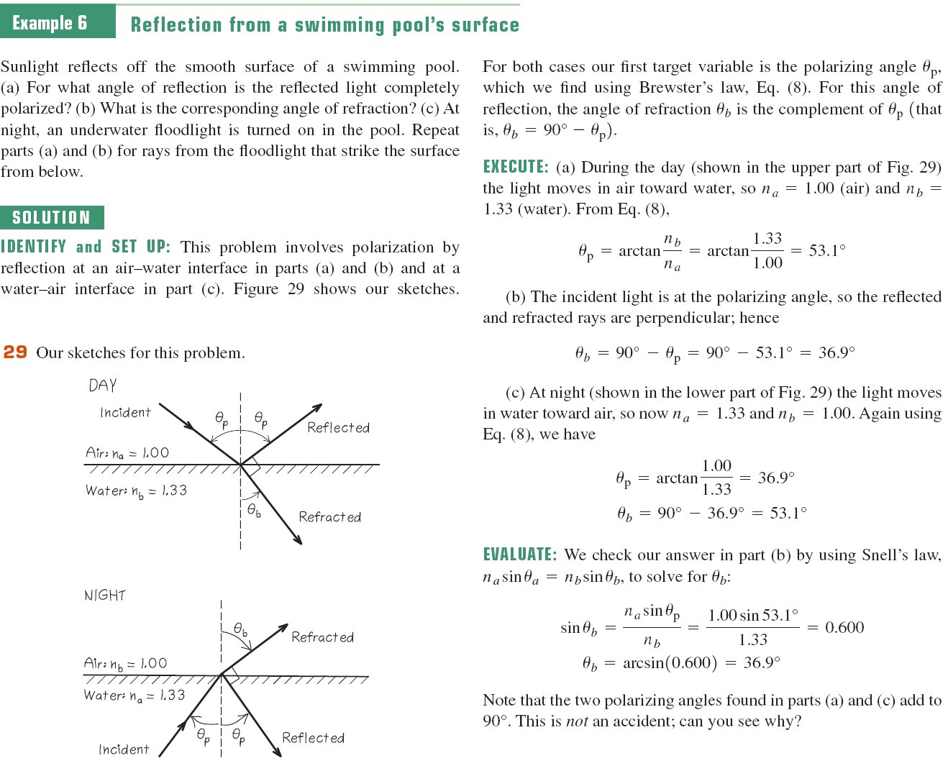

Slide 28
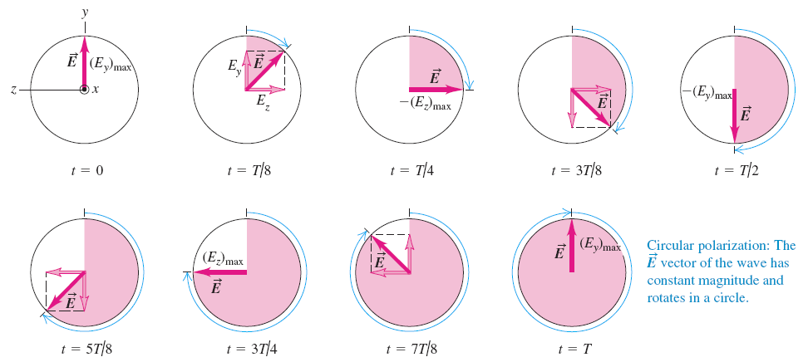
Circular and elliptical polarization
If two component waves differ in phase by a quarter cycle and with the same amplitude. This particular superposition of two linearly polarized waves is called circular polarization.
If the phase difference between two component waves is something other than a quarter-cycle, or if the two component waves have different amplitudes, then each point on the string trances out not a circle but an ellipse. The resulting wave is called elliptically polarized.

Slide 29
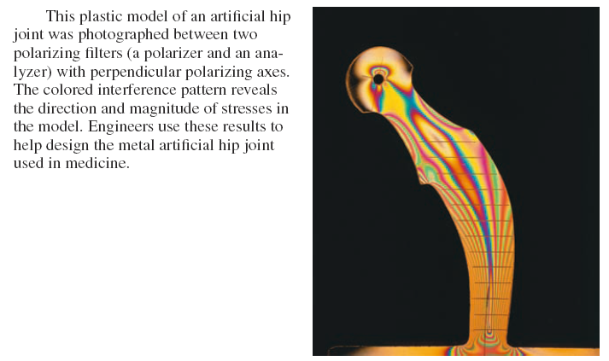
photoelasticity
Some optical materials that are not normally birefringent become so when they are subjected to mechanical stress.
This is the basis of the science of photoelasticity.

Slide 30
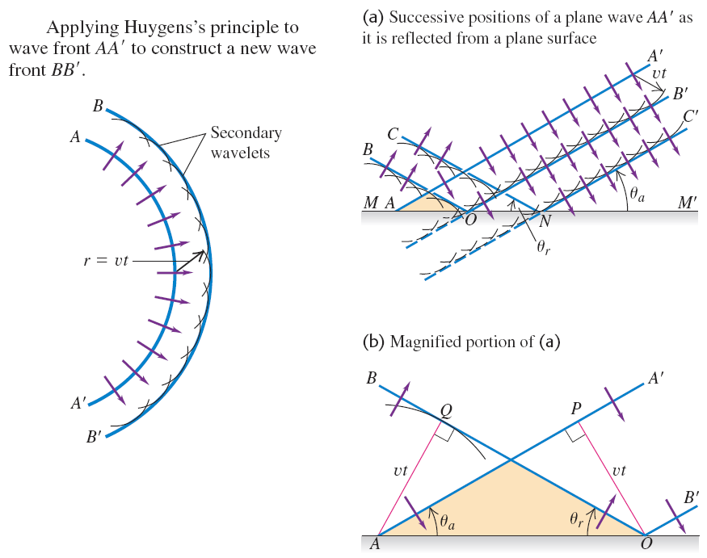
Huygens’s Principle
From the work of Christian Huygens in 1678, the geometrical analysis reveals that every point of a wave front can be considered to be a source of secondary wavelets that spread with a speed equal to the speed of propagation of the wave.

Slide 31
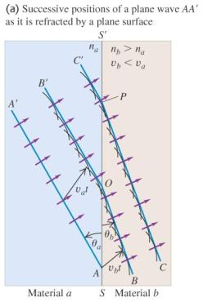
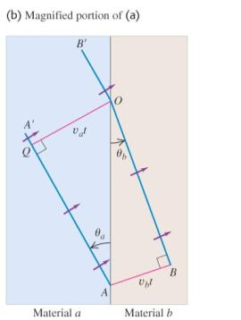
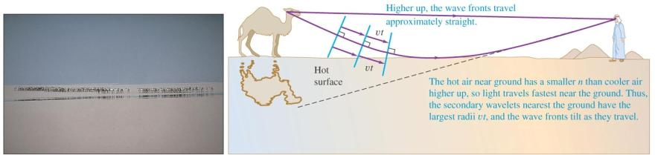
Huygens’s Principle II
Huygens’s work can form an explanation of reflection and refraction.

